Slide 1
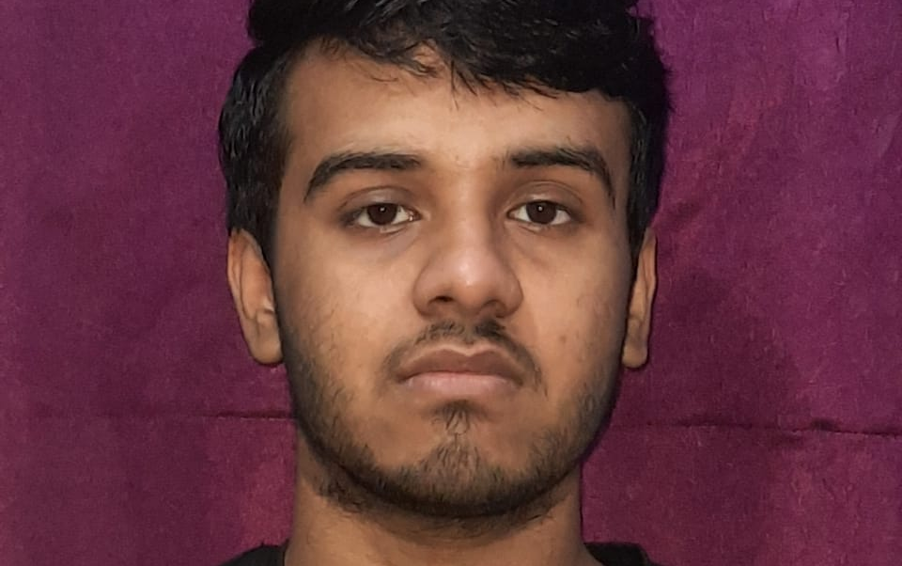
Languages :- C++ , Python
Database :-Oracle, MySQL
DevOps – IAC practices (AWS Cloudformation, Terraform)
•DevOps - CI/CD (AWS CodePipeline, Jenkins)
•DevSecOps & Governance, Branching Strategy
•Source Version with Github, AWS CodeCommit
1. DevOps Projects
•DevOps practices of writing IAC – Infrastructure as Code scripts for Automating Infra into AWS Cloud.
•Developing DevOps CI/CD practice as part of SDLC for end-to-end software delivery which included CICD Workflow for a Continuous Delivery Pipeline for a Lambda Application with AWS CodePipeline, AWS SAM, AWS Code Deploy & AWS Cloudformation by building the Serverless Architecture which includes all the components.
•Involved into AWS DevOps practices for Accenture internal project & designed IAC & CICD solutions for IAM Role’s/policies Serverless Framework with Cloudformation, Serverless Application Module – SAM & CI/CD release deployments for 100+ Serverless Functions along with RestAPI’s.
•Applying DevSecOps Governance integrations & automating Feedbacks, Logging & Monitoring, Approval Gates as part of Continuous Delivery practices.
•Jenkins : Integrating Jenkins to deploy AWS Code Build artifacts with functioning CI/CD Pipeline triggered by code changes pushed to Github repository, deployed on CodeDeploy.
•Terraform : Worked on creating an architecture using Terraform resources in AWS, worked on creating re-usable Terraform resources to improve agility when coding infrastructure.
•MLOps : Practicing & Developing skills into MLOPS ecosystem & integration with DevOps core model scope using CI/CD, Infra-as-code along with services like AWS Glue, Sagemaker & Databricks.
2.Rapid Data labs(Project Under Accenture)
. Worked on Data Visualization tools for creating and Quality Check of Dashboards..
I used SQL and Python scripts for finding remedies to client data shortcoming
3. Amazon Web Services(AWS) - Training under Accenture
Learned Amazon web services like S3, EC2, Lambda.
Trained in S3 fundamentals along with DynamoDB data model concepts with its usability and cost.
Trained and worked on AWS tools like Redshift, Athena, Glue, Kinesis.
Hands on experience with AWS management console.
s.
NEERAJ KUMAR
Data Engineering Analyst
neeraj.co.kumar@accenture.com
+91 - 8920344651
A 2021 college graduate with intern and training experience in web development and SQL.
Neeraj has knowledge of Data Structures & algorithms, Operating system, Database management and has undergone training in AWS and Snowflake architecture under Accenture.
# Education :
Bachelors in Electronics and Communication Engineering from Delhi Technological University(D.T.U.)
DevOps Serverless Framework automation, RestAPIs
•MLOps with AWS glue, Sagemaker, Step Functions
•Datarbricks with ETL, Docker/Kubernets
Databricks Developer foundations capstone

